Slide 1
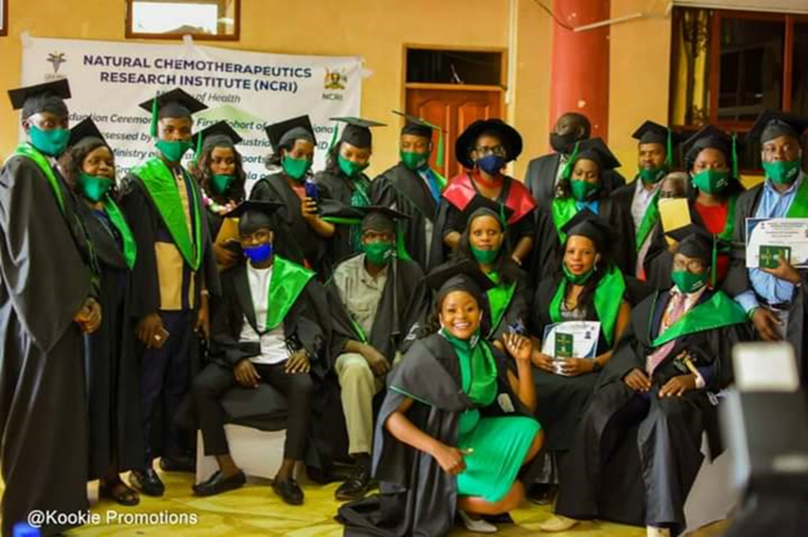
THE HERBALIST CAPACITY BUILDING PROGRAM AT NCRI

Slide 2
OUR FIRST EVER BATCH OF HERBAL GRADUANDS

Slide 3
BACKGROUND
Due to growth in utilization and trade in herbal medicine products in Uganda, Natural Chemotherapeutics Research Institute (NCRI)-under the Uganda National Health Research Organisation (UNHRO)-Ministry of health and Directorate of Industrial Training (DIT) an agency of Ministry of education and sports, established collaborations to formalize training of herbalists and herbal medicines processors. This is a means to improve herbal practitioner practice and formalize the sector.

Slide 4
The training is aimed at developing a formal and recognized certification system for herbalists and herbal medicine processors. During the training for delivery of skills, participatory training methods are adopted. These included lectures, tutorials/ focused group discussion/ clustering group presentations/ discussions demonstrations, field work and practicals

Slide 5
Theory and practicals on the following topics was delivered:
Medicinal plants identification, good agricultural practices, sustainable harvesting of medicinal plants, good manufacturing practices, protective wear & personal hygiene, waste management, first aid kit; contents, composition & use of a fire extinguisher for different types of fire.
Preparation of petroleum base & non petroleum base jellies, preparation of petroleum base and non-petroleum base lotions & creams, preparation of bathing soap, powders, preparation of shower gels & hand washing gels, hair shampoo, herbal syrups, decoctions, tinctures, herbal distillates, herbal ointments, herbal capsules & tablets as well as entrepreneurship skills.
Theory on Human Anatomy and Physiology, reception of patients.
Dosage forms in herbal medicine administration, Dosage forms and label preparation.
The trainees were taken on a field trip to Kampala Pharmaceutical industries (KPI). Here, they were able to familiarize and practically appreciate how capsule and tablets are made.

Slide 6
Achievements
A total of twenty four trainees were equipped with skills in herbal medicine standardization in the different topics including identification of potent medicinal plants, herbal harvesting, herbal processing, herbal formulation, herbal packaging, herbal branding, marketing and prescribing as well as herbal business management. Generally, the trainees were enthusiastic and very interested in the herbal medicine training program.

